Slide 1
2019 Novel Coronavirus COVID-19 (2019-nCoV)
Risks and what are the consequences of the outbreak
Cases of study: France - Germany - Italy

Slide 2
Analysis of the current situation
Source of dataset:
JHU CSSE dataset: ​https://github.com/CSSEGISandData/COVID-19
Our world in data dataset: https://ourworldindata.org/coronavirus-testing#testing-for-covid-19-background-the-our-world-in-data-covid-19-testing-dataset

Slide 3
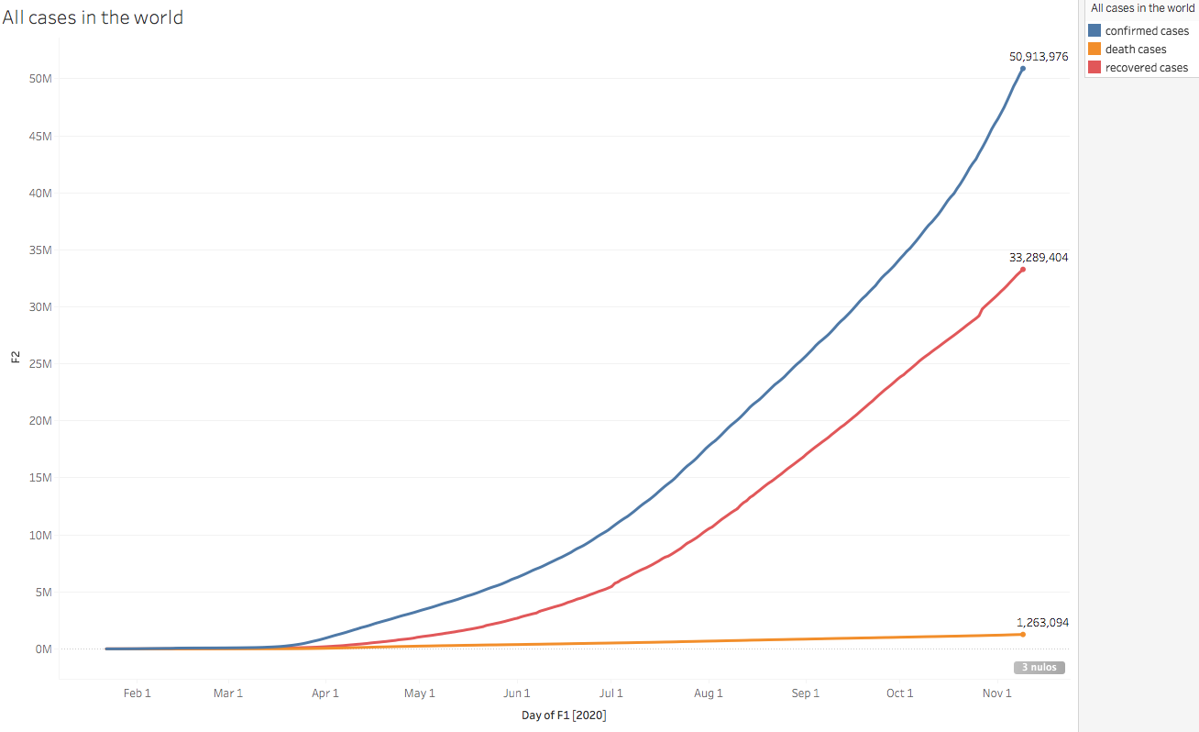
What has happened since the beginning of the pandemic?
From the start of the pandemic, the cases have never slowed down and the curve has never stopped growing: at the beginning, in March with the focus in Europe, and then in the American continent. The recovered cases have never stopped as well, neither the death cases.
There are 50.9 millions of confirmed cases, 33.2 millions of recovered and 1.2 millions of death due to Coronavirus.

Slide 4
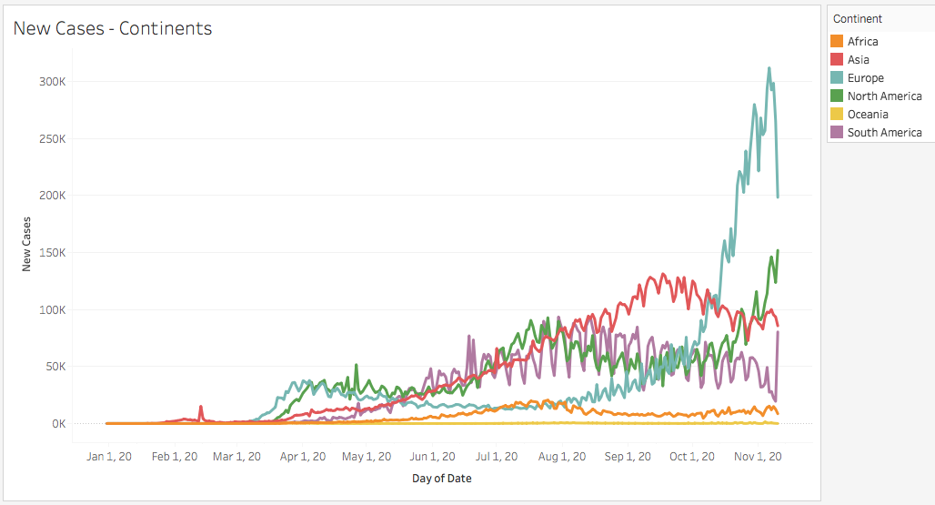
What is the global situation now?
Seeing the new cases registered by continent, there is no doubt that there is a new outbreak in Europe and North America.
Both Europe, with more than 300.000 of confirmed cases and North America with 150.000 new cases are at the beginning of colder weather when people start to stay more indoors and less outside.

Slide 5
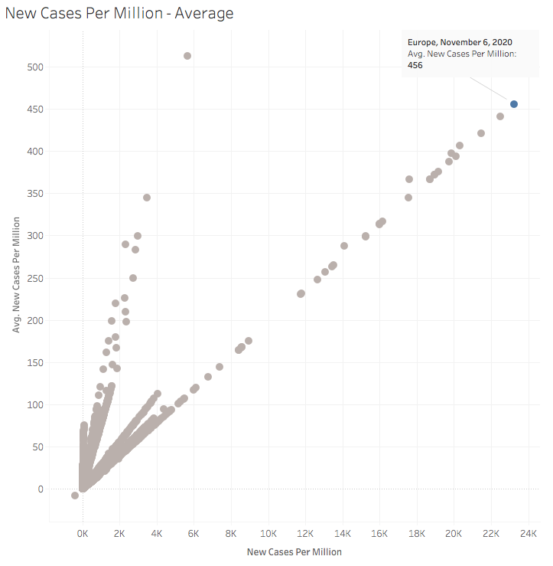
Cases per million
Europe, November 6, 2020
This graph shows the average of New Cases Per Million for the selected brand Europe, November 6, 2020 compared to all brands in the source display.
We have analyzed the peak of Europe, and we have found that it has the highest number of new cases per million inhabitants. Its average total number of cases per million is only surpassed by Oceania, however to date Europe is the focus of the pandemic with the highest growth in cases per million.

Slide 6
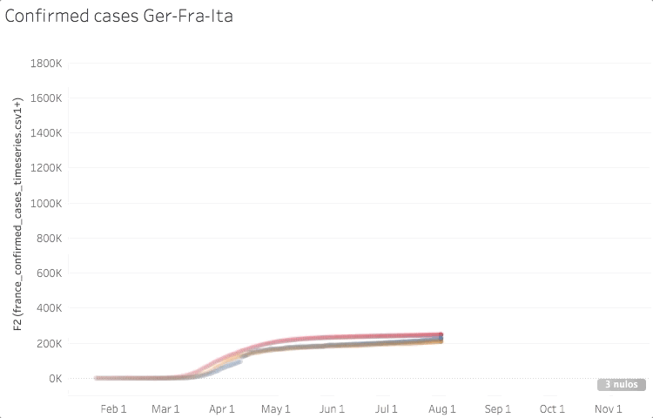
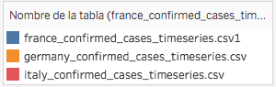
Europe situation: Germany, Italy and France
For a more detailed analysis, let’s see what happens in France, Germany and Italy, 3 differents countries in the focus of the new outbreak.
The 3 countries were in the same line of 200K cases in average until the end of August, when France started to increase its cases rapidly in a exponencial rate.

Slide 7
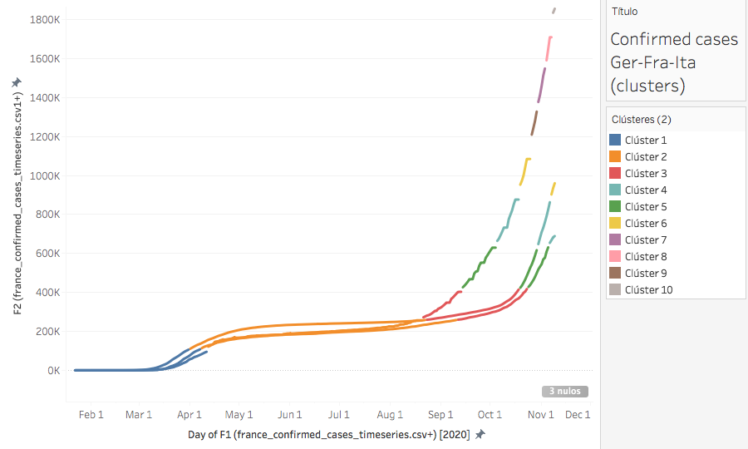
Patterns
Here is a cluster analysis where we can see in orange the flatten curve since the beginning of the pandemic, and in red when it dramatically grew in an exponential rate. This exponential coefficient increased faster in France, but it was similar to the way it occurred soon in Italy and Germany.

Slide 8
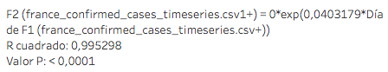
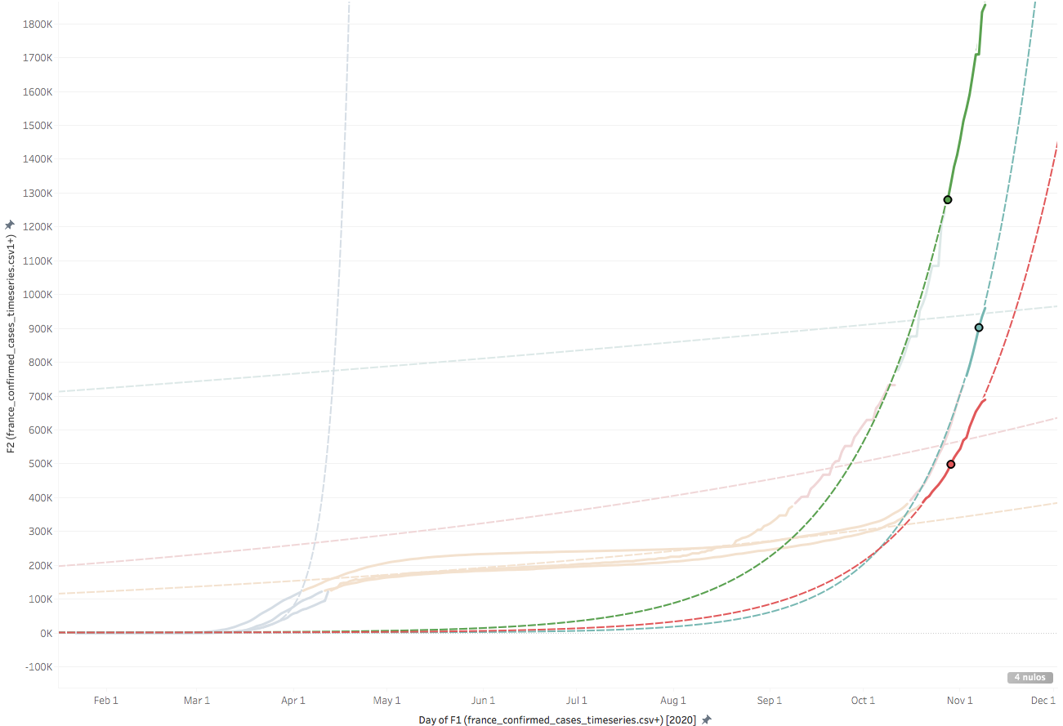
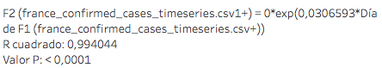
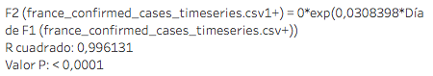
Trend lines
France
Italy
 | Exponential coefficient
France | 0,030
Italy | 0,040
Germany | 0,030
Germany
The exponential rate of the last part of the curve seems to be higher in Italy, but pretty similar in the 3 countries.

Slide 9
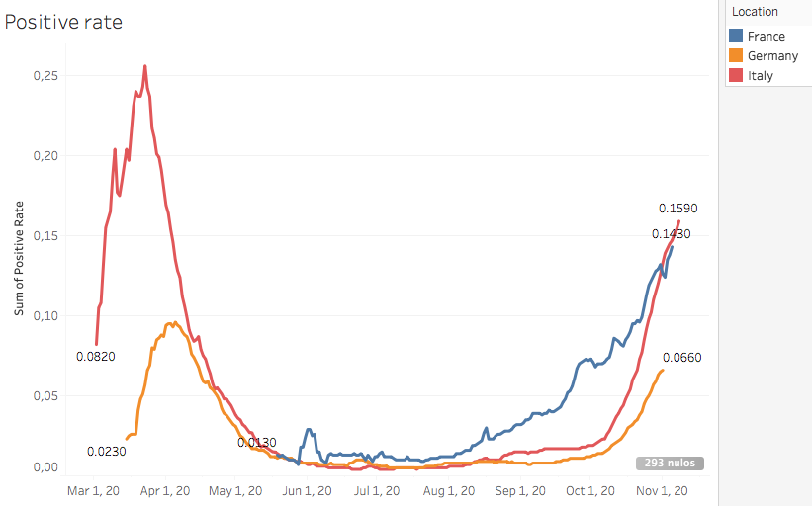
How do these countries test?
A good way to see this is analyzing the positive rate tests between countries. The smaller this rate is, the better the indicator of a good quantity of tests is. The WHO recommends to be 3% or below.
Germany has the best positive rate with 6,6%. On the other hand, Italy has the worst (15%) and France has 14%. All rates above the WHO recommendations indicate a probability of increase of cases in the future and that more tests are needed.

Slide 10
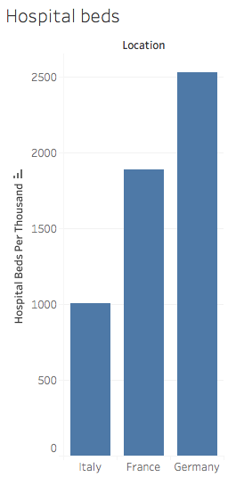
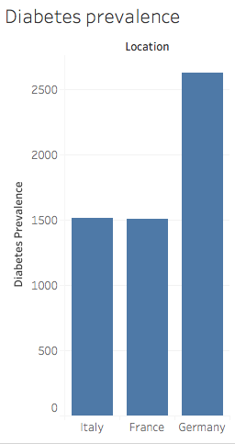
Risks
In order to see the risk of a uncontrollable outbreak, Germany has the highest number of hospital beds per thousand of inhabitants, 500 more than France and the double number of Italy.
On the other hand, Germany has the highest diabetes prevalence, the double of Italy and France.
Diabetes is a risk factor on severe cases of coronavirus.

Slide 11
Conclusions
The coronavirus outbreak epicenter is in Europe right now. The study cases shows that France has the most severe situation with test with highly positive rate and cases increasing exponentially.
Germany and Italy has similar rhythm of increasing cases in the last months, but Germany has the better rate of positivity in tests than Italy, that indicates a better testing strategy.
The uncontrollable situation in France is a risk, with the early outbreak and high increase of cases until today. Germany has the highest diabetes prevalence, but also the most robust health sistem with more than 2500 beds per 1000 inhabitants.
In the future the current lockdowns in those countries want to achieve a decrease of number of cases, but in the short term the curve of all those countries seems to continue growing exponentially.

